Slide 1
Regression Analysis
Multiple Linear Regression
Nicoleta Serban, Ph.D.
Professor
School of Industrial and Systems Engineering
Regression Parameter Estimation

Slide 2

About This Lesson

Slide 3




Parameter Estimation $\left(β_{0},β_{1},…,β_{p}\right),σ^{2}$
To estimate $\left(β_{0},β_{1},…,β_{p}\right)$, find values $\left({\hat{β}}_{0},{\hat{β}}_{1},…,{\hat{β}}_{p}\right)$ that minimize squared error:
$$\sum_{i=1}^{n}{{\left(y_{i}−{\hat{y}}_{i}\right)}^{2}}=\sum_{i=1}^{n}{{\left(\left.y_{i}−({\hat{β}}_{0}+{\hat{β}}_{1}x_{i,1}+...+{\hat{β}}_{p}x_{i,p}\right)\right)}^{2}}={\left(y−X\hat{β}\right)}^{T}\left(y−X\hat{β}\right)$$
By linear algebra (Orthogonal Decomposition Theorem) or differentiation:
$$X^{T}\left(y−\hat{y}\right)=X^{T}\left(y−X\hat{β}\right)=0$$
So
$X^{T}X\hat{β}=X^{T}y$
If $X^{T}X$ is invertible,
$$\hat{β}={\left(X^{T}X\right)}^{−1}X^{T}y$$
Notes:
Why n-p-1? Examination question.

Slide 4
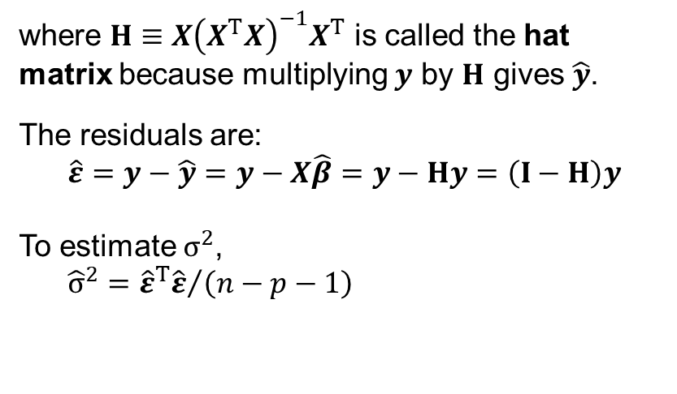

Parameter Estimation $\left(β_{0},β_{1},…,β_{p}\right),σ^{2}$
The fitted values are $\hat{y}=X\hat{β}$, and $\hat{β}={\left(X^{T}X\right)}^{−1}X^{T}y$, so
$$\hat{y}=X\hat{β}=X{\left(X^{T}X\right)}^{−1}X^{T}y=Hy$$
where $H≡X{\left(X^{T}X\right)}^{−1}X^{T}$ is called the hat matrix because multiplying $y$ by $H$ gives $\hat{y}$.
The residuals are:
$\hat{ε}=y−\hat{y}=y−X\hat{β}=y−Hy=\left(I−H\right)y$
To estimate $σ^{2}$,
${\hat{σ}}^{2}={{\hat{ε}}^{T}\hat{ε}}/{\left(n−p−1\right)}$

Slide 5
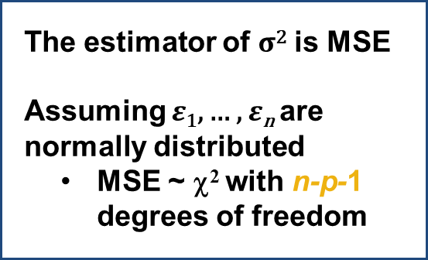
Parameter Estimation $\left(β_{0},β_{1},…,β_{p}\right),σ^{2}$
The fitted values are $\hat{y}=X\hat{β}$, and $\hat{β}={\left(X^{T}X\right)}^{−1}X^{T}y$, so
$$\hat{y}=X\hat{β}=X{\left(X^{T}X\right)}^{−1}X^{T}y=Hy$$
where $H≡X{\left(X^{T}X\right)}^{−1}X^{T}$ is called the hat matrix because multiplying $y$ by $H$ gives $\hat{y}$.
The residuals are:
$\hat{ε}=y−\hat{y}=y−X\hat{β}=y−Hy=\left(I−H\right)y$
To estimate $σ^{2}$,
${\hat{σ}}^{2}={{\hat{ε}}^{T}\hat{ε}}/{\left(n−p−1\right)}$
The estimator of $σ$² is MSE
Assuming $ε$₁, … , $ε$_{n} are normally distributed
  MSE ~ χ² with n-p-1 degrees of freedom

Slide 6

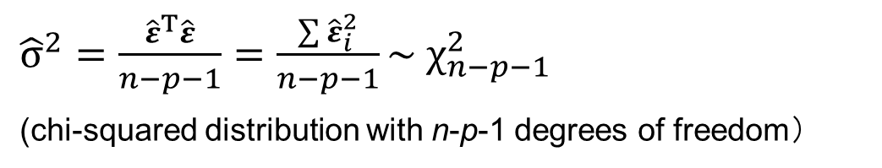

Parameter Estimation
${\hat{σ}}^{2}=\frac{{\hat{ε}}^{T}\hat{ε}}{n−p−1}=\frac{\sum{{\hat{ε}}_{i}^{2}}}{n−p−1}\text{\sim } χ_{n−p−1}^{2}$
(chi-squared distribution with n-p-1 degrees of freedom）
Assuming ${\hat{ε}}_{i} \sim { ε}_{j} \sim N\left(0,σ^{2}\right)$
Estimating $σ^{2}$ Sample variance
This is the sample variance estimator, except we use n-p-1 degrees of freedom. Why?

Slide 7




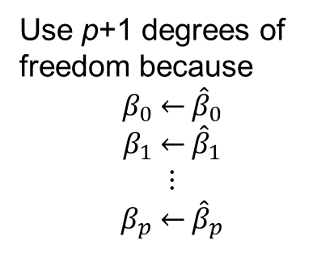
Parameter Estimation
Recall that
$$ε_{i}\text{=}\left( y_{i} \text{−} \left(β_{0} \text{+}β_{1}{\text{x}}_{i,1}\text{+}\text{⋯}\text{+}β_{p}{\text{x}}_{i,p} \right)\right)$$
Use p+1 degrees of freedom because
$$β_{0} \text{←} {\hat{β}}_{0}$$
$$β_{1} \text{←}{ \hat{β}}_{1}$$
$$⋮$$
$$β_{p} \text{←}{ \hat{β}}_{p}$$
Replaced by ${\hat{ε}}_{i}\text{=}\left( y_{i} \text{−} \left({\hat{β}}_{0} \text{+}{\hat{β}}_{1}{\text{x}}_{i,1}\text{+}\text{⋯}\text{+}{\hat{β}}_{p}{\text{x}}_{i,p} \right)\right)$
Thus, assuming that
$$ε_{i} \sim N\left(0,σ^{2}\right)$$
$${\hat{\text{σ}}}^{2} \text{= }\text{MSE} \text{\sim } χ_{n−p−1}^{2}$$
(This is called the sampling distribution of ${\hat{\text{σ}}}^{2}$.)

Slide 8

Summary

